Slide 1
利用LSTM與主機端資訊管理write buffer的方法
Presenter : Sheng-Ying-Huang
Adviser: Dr.Hsung-Pin Chang
Department of Computer Science and Engineering National Chung Hsing University

Slide 2
Outline
Introduction
Motivation
Contribution
Background
Design
Experiment
Conclusion

Slide 3



Introduction
Pros
SSD
Price
Fast
capacity
Resistance
Notes:
used in portable storage devices and handheld devices.
Recently, flash memory has been adopted by personal computers and servers in the form of onboard cache and solid-state disk (SSD).

Slide 4
Introduction
D
Cons
Out-of-place-update
Lifetime
Write request
update
D
Invalid
D
valid
Operation | Unit
Read | Page
Write | Page
Erase | Block
C
Valid
B
Valid
A
Valid
SSD
When GC happen
Notes:
這裡要提，因為SSD是由NAND flash memory所組成的，而flash memory有幾項缺點，首先是：……

Slide 5
Introduction
What if there are too many write operations?
solution: write buffer(based on RAM)
Page cache
Host
In-place-update
Write buffer
SSD
FTL
Flash memory
Notes:
Reduce erase count->reduce waiting time->good performance

Slide 6
Introduction
Page 8 overwrite many times
Page cache
Page cache
Dirty page
9 10 11 12 13
5
6
7
8
9 10 11 12 13
5
6
7
8
Dirty page
hit
Erase
Write buffer
8
7
6
5
Flash memory
SSD
SSD

Slide 7
Outline
Introduction
Motivation
Contribution
Background
Design
Experiment
Conclusion

Slide 8
Motivation
Write buffer can improve SSD lifetime, but we need to make sure write buffer has high hit ratio.
Current write buffer design: don’t know the trend of request
Page cache
victim
Write buffer
5 4 8 9 11 25 33 15 1 2 16 28 7
MRU
LRU
request
19 16 15 14 7 7 7 7 7 7 7 7 28 16 2
We never know future request

Slide 9
Outline
Introduction
Motivation
Contribution
Background
Design
Experiment
Conclusion

Slide 10
Contribution
Host
Page cache
AI model
Write buffer
Hint queue
FTL
Flash memory
SSD

Slide 11
Outline
Introduction
Motivation
Contribution
Background
Host-aware write buffer management
Neural network
RNN
LSTM(Long short-term memory)
Design
Experiment
Conclusion

Slide 12
Host-aware write buffer management
Background
Host
Page cache
Write dirty page in three cases:
Replacement
Dirty amount
Dirty time
Store dirty page
Hint queue help write buffer select victim
Hint queue
Write buffer
Flash memory
SSD
Notes:
Write buffer管理分成以physical block管理或是logical block管理，如果是以physical block管理……

Slide 13
Replacement
Background
Page cache size=10 pages
Clean page
46
11
94
7
68
55
39
21
5
15
Page cache
15
Dirty page
MRU
LRU
Write buffer
SSD

Slide 14
Flush due to dirty page amount
Background
Clean page
Page cache size=10 pages
Dirty page ratio=40%
Dirty page ratio=20%
Dirty page ratio=30%
Dirty page
Dirty page ratio=10%
51
84
5
84
16
28
21
19
19
19
5
5
71
1
15
15
Page cache
15
MRU
LRU
Write buffer
SSD

Slide 15
Flush due to dirty time
Background
Clean page
46
11
94
Page cache
46
11
94
7
68
55
39
21
5
15
Dirty page
MRU
LRU
More than 30 seconds
Global time flag
Write buffer
SSD

Slide 16
Background
Hint queue
Using T1 information predict T2
Using T2 information predict T3
Page cache
Hint queue
Page cache
Hint queue
Page cache
time
T1
T1.5
T2
T2.5
T3
SSD
SSD

Slide 17
Background
Hint queue
Dirty time
9
25
12
5
1
57
44
31
25
12
8
5
Page cache
9
1
57
38
MRU
replacement
LRU
Dirty amount
Hint queue
Write buffer
Flash memory
SSD

Slide 18
Background
Choose victim block
How
Block overwrite
Hint queue
Total=How+Hnw
Hnw
Block new write
Case 1: find min total block first
Case 2: find large block first
Case 3: find LRU block

Slide 19
Choose victim block
Background
How
Hint queue
91
65
98
10
21
35
44
Hnw
Min total first
MRU
LRU
91
1
51
Write buffer
44
98
21
65
10
35
0
B0
B1
B2
B3
Total=3
Total=2
Total=2
Total=0
SSD

Slide 20
Choose victim block
Background
How
Hint queue
91
65
33
58
98
10
49
21
1
51
0
Hnw
Large block first
MRU
LRU
58
91
49
1
51
Write buffer
33
98
21
65
10
35
0
B0
B1
B2
B3
Total=4
Total=3
Total=2
Total=2
Size=2
Size=2
Size=3
Size=2
SSD

Slide 21
Choose victim block
Background
How
Hint queue
91
65
33
58
98
1
51
Hnw
LRU first
MRU
LRU
33
91
58
1
51
Write buffer
98
21
44
65
10
35
0
B0
B1
B2
B3
Total=3
Total=2
Total=1
Total=1
Size=2
Size=2
Size=3
Size=3
SSD

Slide 22
Outline
Introduction
Motivation
Contribution
Background
Host-aware write buffer management
Neural network
RNN
LSTM(Long short-term memory)
Design
Experiment
Conclusion

Slide 23
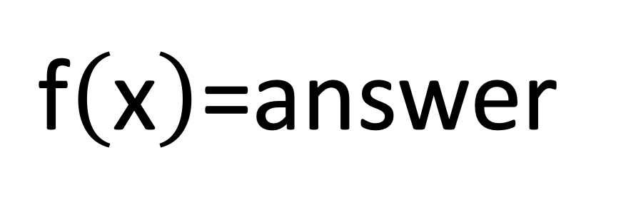

Neural network
Background
Background
Neural network
Label
Output layer
x1
y1
0
Activation function
x2
y2
0
…....
…....
…....
1
xn
yn
classification
Weight
neural
Input feature
(vector)
Calculate loss
$$\sum_{i=0}^{n}{xi∗wi}$$
$\text{f}\left(\text{x}\right)\text{=}$answer
Backpropagation
Notes:
Goal: find the function
給這個函式一個input，他能夠回傳這個任務（預測圖片＆天氣＆股票價位）的結果
而這樣的函式，是沒辦法靠人所找出來的，因此需要機器去逼近！

Slide 24
Outline
Introduction
Motivation
Contribution
Background
Host-aware write buffer management
Neural network
RNN(recurrent neural network)
LSTM(Long short-term memory)
Design
Experiment
Conclusion

Slide 25
Background
RNN(recurrent neural network)
Neural network
memory
RNN
Voice Recognition…but only for short term speech(ex:Siri)
Simple RNN
Short term memory
RNN
LSTM
Long short-term memory
Long term speech voice recognition
With forget gate
Notes:
這裡講完，然後簡單舉例，預測我們的reqeuest需要用LSTM，因為若使用simple RNN會有梯度消失&爆炸問題

Slide 26
LSTM
Background
Y1
Y2
Y3
Yn
Output
Memory
cell
Memory
cell
Memory
cell
Memory
cell
X1
X2
X3
Xn
Time 1
Time 2
Time 3
Time n

Slide 27
Background
LSTM
x1
LSTM unit
x2
LSTM unit
softmax
Y(4*1 vector)
Output
(0/1/2)
x3
LSTM unit
Input feature
(vector)
LSTM unit
[1,0,0]
Or
[0 ,1,0]
Or
[0,0,1]
LSTM layer

Slide 28
Outline
Introduction
Motivation
Contribution
Background
Design
Architecture
Write buffer management: AI
Offline
Online
Experiment
Conclusion

Slide 29
Architecture
Host
Page cache
AI model
Late queue
Hint queue
Mean queue
Soon queue
MRU
LRU
Write buffer
Flash memory
SSD
29

Slide 30
Offline
Architecture
Write buffer simulator
Generate duration label
Training

Slide 31




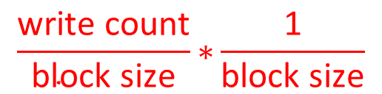
Offline
Architecture
Offline
Benefit function
Oracle
Write buffer simulator
AI training
$$\frac{\text{write} \text{count}}{\text{block} \text{size}}\text{∗}\frac{\text{1}}{\text{block} \text{size}}$$
Duration value
(In write buffer)
Number of page in block

Slide 32
Write buffer simulator
Offline
2
Block | Benefit value
B0 | 0.1
B1 | 0.5
B2 | 0.45
B3 | 0.7
B4 | 0.3
B5 | 0.6
B6 | 0.5
B7 | 0.73
5
8
Write buffer
1
4
7
0
3
6
9
B0
B1
B2
B3
Block/Time | T1 | T2 | T3 | T4 | T5 | T6
B0 | 0
Block/Time | T1 | T2 | T3 | T4 | T5 | T6
B0 | 0 | 1 | 2
B1 |  |  | 0
Block/Time | T7 | T8 | T9 | T10 | T11 | T12
B0 | 6 | 7 | 8
B1 | 4 | 5 | 6 | 7
B2 | 0 | 1 | 2 | 3
B3 |  |  |  | 0
Block/Time | T1 | T2 | T3 | T4 | T5 | T6
B0 | 0 | 1 | 2 | 3
B1 |  |  | 0 | 1
Block/Time | T1 | T2 | T3 | T4 | T5 | T6
B0 | 0 | 1 | 2 | 3 | 4
B1 |  |  | 0 | 1 | 2
Block/Time | T1 | T2 | T3 | T4 | T5 | T6
B0 | 0 | 1 | 2 | 3 | 4 | 5
B1 |  |  | 0 | 1 | 2 | 3
Block/Time | T7 | T8 | T9 | T10 | T11 | T12
B0 | 6
B1 | 4
B2 | 0
Block/Time | T1 | T2 | T3 | T4 | T5 | T6
B0 | 0 | 1
Block/Time | T7 | T8 | T9 | T10 | T11 | T12
B0 | 6 | 7
B1 | 4 | 5
B2 | 0 | 1
Block/Time | T7 | T8 | T9 | T10 | T11 | T12
B0 | 6 | 7 | 8
B1 | 4 | 5 | 6
B2 | 0 | 1 | 2
Duration value
B0 duration=8

Slide 33
Offline
Write buffer simulator
LB 0
LB 1
LB 2
LB 3
LB 4
LB 5
LB 6
LB 7
Write buffer simulator
LB 0
4
LB 1
5
LB 2
14
LB 3
19
Block
duration
Block
duration
Block
duration
Block
duration
LB 4
9
LB 5
7
LB 6
13
LB 7
102
Block
duration
Block
duration
Block
duration
Block
duration

Slide 34
Generate duration label
Offline
Transform duration value into duration label
Duration value : d
t=2560 pages=64*40 pages=40 blocks
Threshold:t
d<t
d>=t & d<5t
d>=5t
Soon->0
Mean->1
Late->2

Slide 35
Offline
Training
Y
Calculate loss
Arrive time
Duration label
Read count
Write count
LSTM
LSTM
LSTM
output
softmax
Block size
Block write count
[1,0,0]
Or
[0 ,1,0]
Or
[0,0,1]
Page write count
Backpropagation
Input feature
Notes:
Read count->read page number
Write count->write page number
Block write count==block total write page count

Slide 36
Outline
Introduction
Motivation
Contribution
Background
Design
Write buffer management: AI
Offline
Online
Write buffer management: AI+Hint
Experiment
Conclusion

Slide 37
Online
Architecture
Testing
Demoting

Slide 38


Online
Architecture
Online
Demoting
Predict duration label
Request
LSTM model
Write buffer

Slide 39
Demoting
Online
Host
Page cache
Late queue
MRU
LRU
Demoting
Mean queue
MRU
LRU
Soon queue
MRU
LRU
Write buffer
Flash memory

Slide 40
Demoting
Online
Demoting
Threshold=4000
Block | Pass request count
A | 7
B | 5182
C | 5697
D | 21
E | 4466
F | 4458
G | 9
H | 6
I | 413
late queue
A
J
K
L
B
C
MRU
LRU
mean queue
G
M
N
O
F
E
MRU
LRU
soon queue
H
D
I
P
MRU
LRU
Write buffer
If access, reset to 0

Slide 41
Outline
Introduction
Motivation
Contribution
Background
Design
Write buffer management: AI
Offline
Online
Write buffer management: AI+Hint
Experiment
Conclusion

Slide 42
Write buffer management: AI+Hint
Architecture
Using Hint information

Slide 43


Online
Architecture
Online
Write buffer
Request
Predict duration label
LSTM model
Page Cache
Hint Queue

Slide 44
Using hint information
Online
E
B
C
A
D
Victim block
Write buffer—soon queue
MRU
LRU
Page 51 is not in block D
Page 51
New write
Page 40
overwrite
Page 40
Page 25~39
Page 24
Page 24
overwrite
Page 2~23
Page 1
Page 1
overwrite
D
Hint

Slide 45
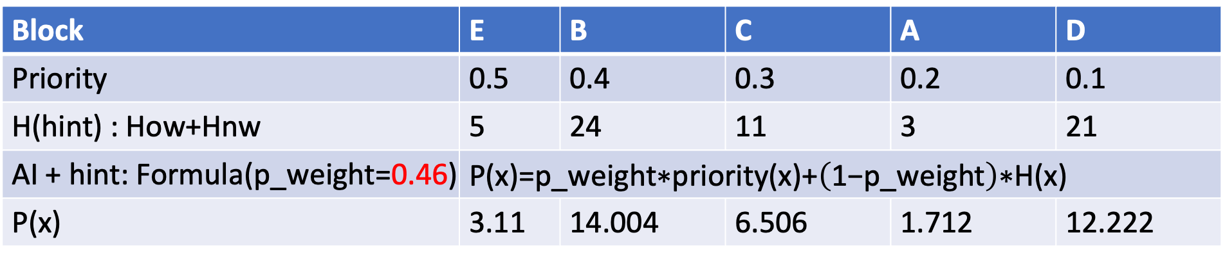
Using hint information
Online
Write buffer soon queue
Victim block
E
B
C
A
D
MRU
LRU
LRU
Min total(Hint)
Block | E | B | C | A | D
Priority | 0.5 | 0.4 | 0.3 | 0.2 | 0.1
H(hint) : How+Hnw | 5 | 24 | 11 | 3 | 21
AI + hint: Formula(p_weight=0.46) | $$\text{P}\text{(}\text{x}\text{)=}\text{p}\text{_}\text{weight}\text{∗}\text{priority}\text{(}\text{x}\text{)+}\left(\text{1−}\text{p}\text{_}\text{weight}\right)\text{∗}\text{H}\text{(}\text{x}\text{)}$$
P(x) | 3.11 | 14.004 | 6.506 | 1.712 | 12.222

Slide 46
Outline
Introduction
Motivation
Contribution
Background
Design
Experiment
Conclusion

Slide 47
Experiment
Environment setting
Our experiment is implemented in SSD extension for DiskSim-4.0 and LSTM model is built in Keras.
Offline parameter
Time stamp | 16
Input shape | 16*6
Activate function | Softmax
Trace | Number of Requests | Write ratio | Sequential write ratio | P_weight | Demoting_threshold
Postmark | 367941 | 53% | 67% | 0.9 | 7000
UG-fileserver | 560144 | 74% | 68% | 0.9 | 8000
Iozone | 1405227 | 70% | 0.9% | 0.3 | 5000
Notes:
Keras is an API written in Python.

Slide 48
Experiment
Hit ratio
Notes:
Q: 為什麼隨著cache size變大，our method越來越好，甚至超越學長論文?
A: 因為cache size小的時候，LRU端的資料不見得是code data，但是因為容量有限，只能將資料踢下去，隨著cache size變大，實際上踢下去的資料會變成code data，因為容量變大，位於LRU端的資料會是真正的code block
但學長的論文本來就不是看LRU，而是以Hint資訊為主軸，因此加大Cache size對學長的論文來說不會造成太大的影響

Slide 49
Experiment
Hit ratio
Notes:
Classic version of performance

Slide 50
Hit ratio
Experiment
Notes:
In 16MB, seems like AI>AI+Hint, that is because AI p_weight=1 is the best.

Slide 51
Response time
Experiment
Notes:
整體而言，這兩個workload表現都比Host-aware好，其中UG-fileserver中，AI比AI+Hint好，那是因為AI+Hint中，考量Write count所佔的比重會比GC cost更高，因為在AI，考量Write count & GC cost會是一半一半，但一旦與Hint結合，Write count比重會增加，因為Hint queue本身只考慮write count

Slide 52
Response time
Experiment
Notes:
在這個workload，由於hit ratio成長幅度有限，而AI、AI+Hint又容易挑選出GC cost比較高的block為victim block，這種情況下Response time就容易飆高

Slide 53
Improvement
Experiment
High write ratio and sequential write ratio
Iozone: low sequential write ratio
Postmark: low write ratio
Notes:
Postmark主要是GC在拖延時間
UG-fileserver部分，顯然踢下去的block相對來說為large block，因此response time不會像Postmark差距那樣多

Slide 54
Conclusion
Select victim block
AI
LSTM
Hint Queue
Performance
AI hit ratio improvement up to 20%
AI+Hint hit ratio improvement up to 40%

Slide 55
Thanks for your listening

